Slide 1
PRUDENTIAL LIFE INSURANCE
Risk Analysis| Team-8| Harsh Pandey, Mark Tiburu, Sarang Wardadkar

Slide 2
Project Goals
The objective is to develop a predictive model for risk classification and calculating eligibility automatically, given the client data.
The Risk level helps Prudential Life insurance in providing an exact Quote of Life Insurance for each individual.

Slide 3
Exploratory Data Analysis:
The Prudential life insurance dataset has 127 independent variables and 1 dependent variables with over 58000 records. These 128 features are either continuous, discrete or categorical in nature.
The ‘Response’ field in the dataset is the dependent variable (Y) . The several levels for ‘Response’ variable range from 1- 8 , where 8 is the highest level of risk
Predictor Variable (X) :
X | Y | Type
product_info | 7 | categorical
age | 1 | continuous
height | 1 | continuous
weight | 1 | continuous
BMI | 1 | continuous
employment_info | 6 | continuous
insurance_history | 6 | categorical
Family_history | 9 | continuous
medical_history | 5 | discrete
medical_keywords | 41 | discrete

Slide 4
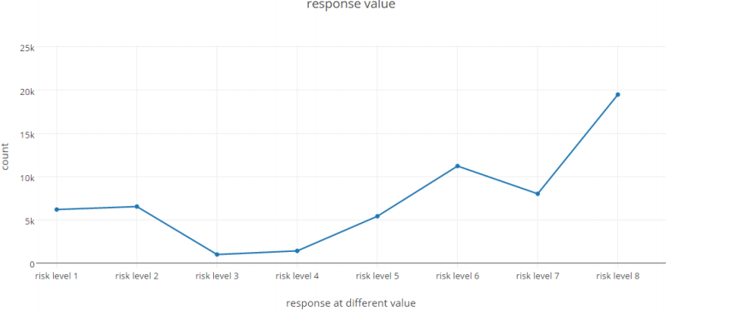
Risk Analysis of Given Train Dataset:

Slide 5
Use Case
You’re an Engineer at a Life Insurance Company
Given over a hundred variables describing attributes of life insurance applicants
Predict “Response” variable for each Id in the test set
Where, “Response” is an ordinal measure of risk that has 8 levels.

Slide 6
Data Cleaning:
Removed the dimensions containing more than 60% of missing values.
Removed the dimensions having more than 6 categories.
Data Imputation:
Imputed the missing values with the mean for continuous or discrete variables.
Dimension Reduction:
We used PCA to reduce the dimensions for the remaining columns.

Slide 7
Linear Regression
It’s a method to predict a target variable by fitting the best linear relationship between the dependent and independent variable.
Simple linear regression has one independent variable whereas a multiple linear regression has more than one independent variables

Slide 8
Approach for Linear Regression
Prepare training and test data typically a 70-30 split.
We only consider the numerical data.
Create a data frame with label and features.
Use assembler to convert input values to a vector ,required by machine learning algorithm to train a model.
Fit the model to Data and summarize.

Slide 9
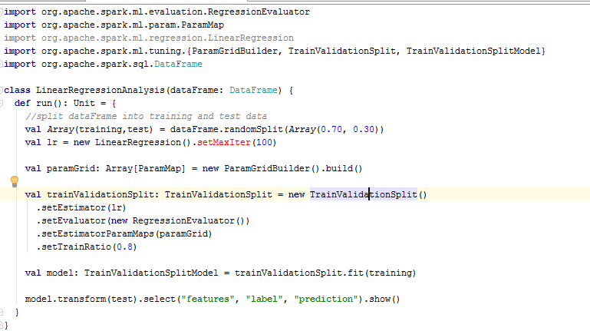

Code Screenshot

Slide 10
Decision Tree
Decision tree builds regression or classification models in a tree structure.
It divides the dataset into smaller and smaller subsets until the datasets are pure, and builds an associated decision tree incrementally.
The final result is a tree with decision nodes and leaf nodes.

Slide 11
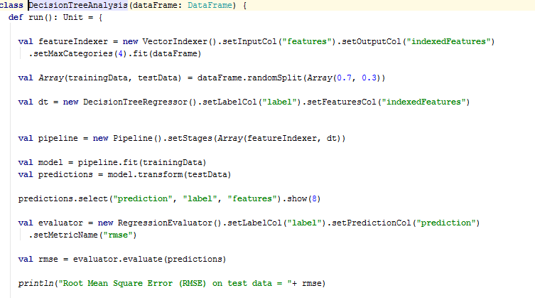
Code Screenshot

Slide 12
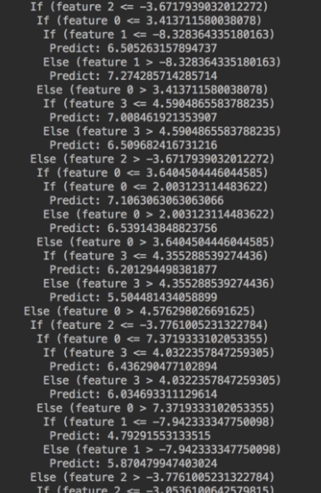
Decision Tree Result

Slide 13
Logistic Regression
Logistic regression is a statistical method for analyzing a dataset in which there are one or more independent variables that determine an outcome.
The outcome is measured with a dichotomous variable (in which there are only two possible outcomes).
The goal of logistic regression is to find the best fitting (yet biologically reasonable) model to describe the relationship between the dichotomous characteristic of interest (dependent variable = response or outcome variable) and a set of independent (predictor or explanatory) variables.

Slide 14
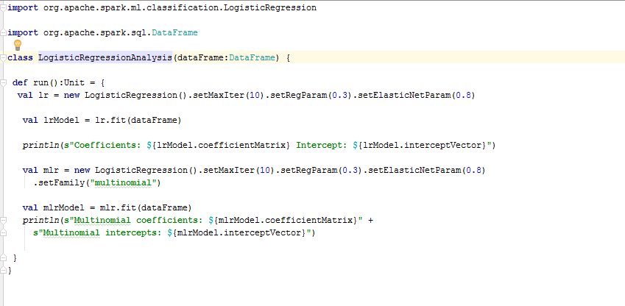
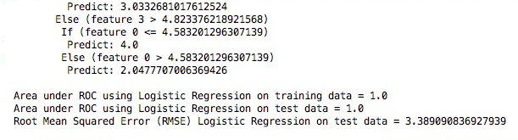
Code Screenshot

Slide 15
Conclusion
Regression | RMSE
Linear Regression | 2.18
Decision Tree Logistic Regression | 2.23 3.3
For Prudential Dataset, our analysis shows that Linear Regression best fit the data.
We had to skip the XGBoost algorithm because spark didn’t support it without us installing a third party dependency which wasn’t quite working. We did instead write logistic regression as our third algorithm
We learned that Data frames are easier to work with than RDD’s in our case and they can run certain optimizations due to its tabular format and additional meta data.
Streamlined end-to-end: Developing machine learning models is a multistep journey from data ingest through trial and error to production. Building MLlib on top of Spark makes it possible to tackle these distinct needs with a single tool.

Slide 16
Acceptance Criteria
To successfully predict risk for customers given various inputs
Calculate RMSE values for each algorithm and determine the best algorithm based on the lowest RMSE value.
Lower RMSE value indicate higher precision for ML algorithm and vice versa.
All acceptance Criteria were achieved except XG Boost.

